Slide 1

Understanding the cross-section of U.S. REIT returns
DSI 24 Capstone Project
by
Ethan Leow

Slide 2
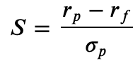
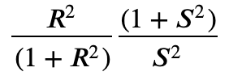
Problem Statement
I am a portfolio manager at a real estate investment fund
According to Campbell and Thompson (2008), small improvements in R² lead to large gains in investment performance, where expected gain =
S is the Sharpe ratio earned by a passive buy-and-hold investor
My goal is to use machine learning to improve the R² of my portfolio holdings of U.S. REITs.
R² = R-squared of portfolio

Slide 3
What are REITs
Real Estate Investment Trusts
Really boring stocks…typically owned by retirees or pension funds
need to give out >90% of their annual income (mostly rental yield)
this asset class tends to behave more like bonds than stocks…
Hence, REITS are typically ignored by financial literature

Slide 4
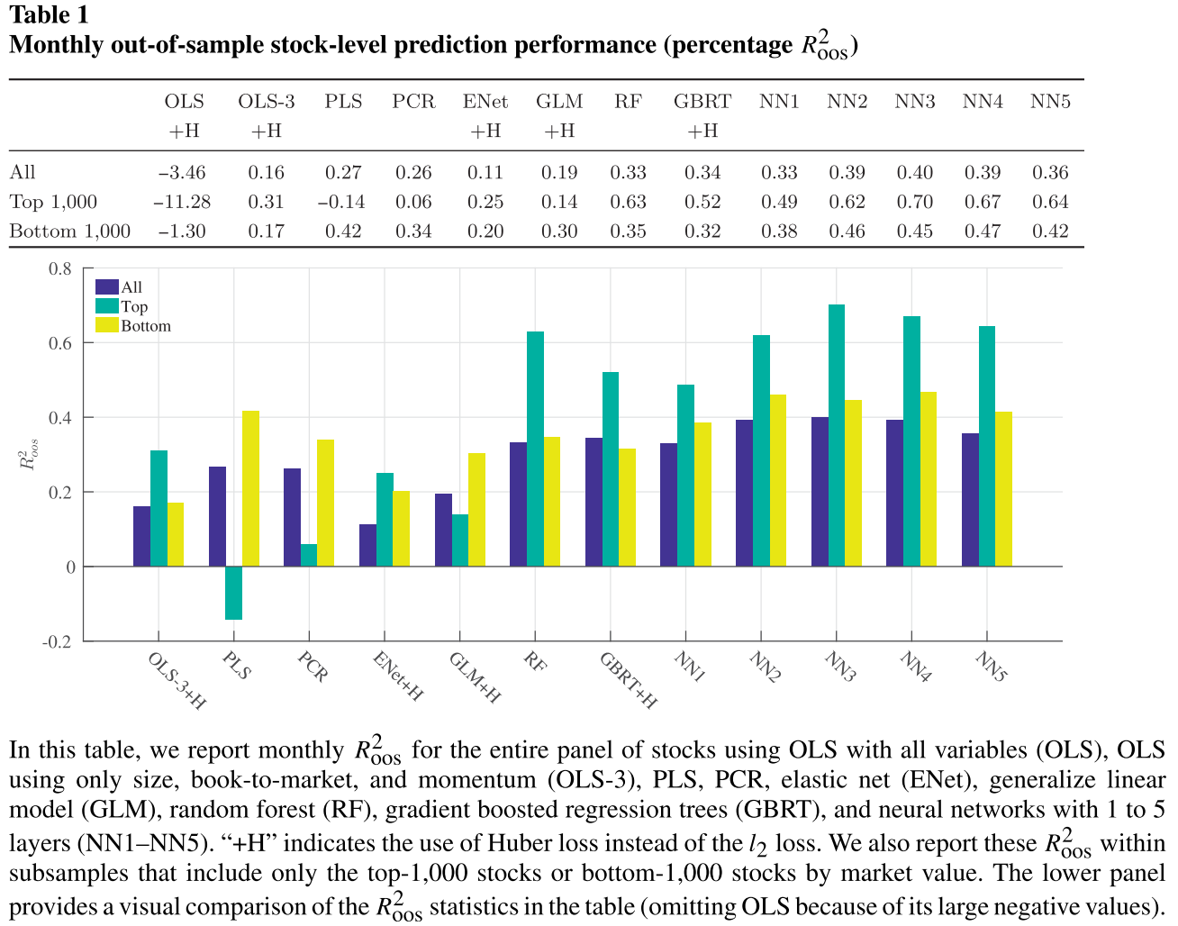
Empirical Asset Pricing and Machine Learning
Nascent subject in financial research
Portfolio managers don’t like ‘black box’ models that they don’t understand, or explain to investors
Gu, Kelly, Xiu (2020)

Slide 5
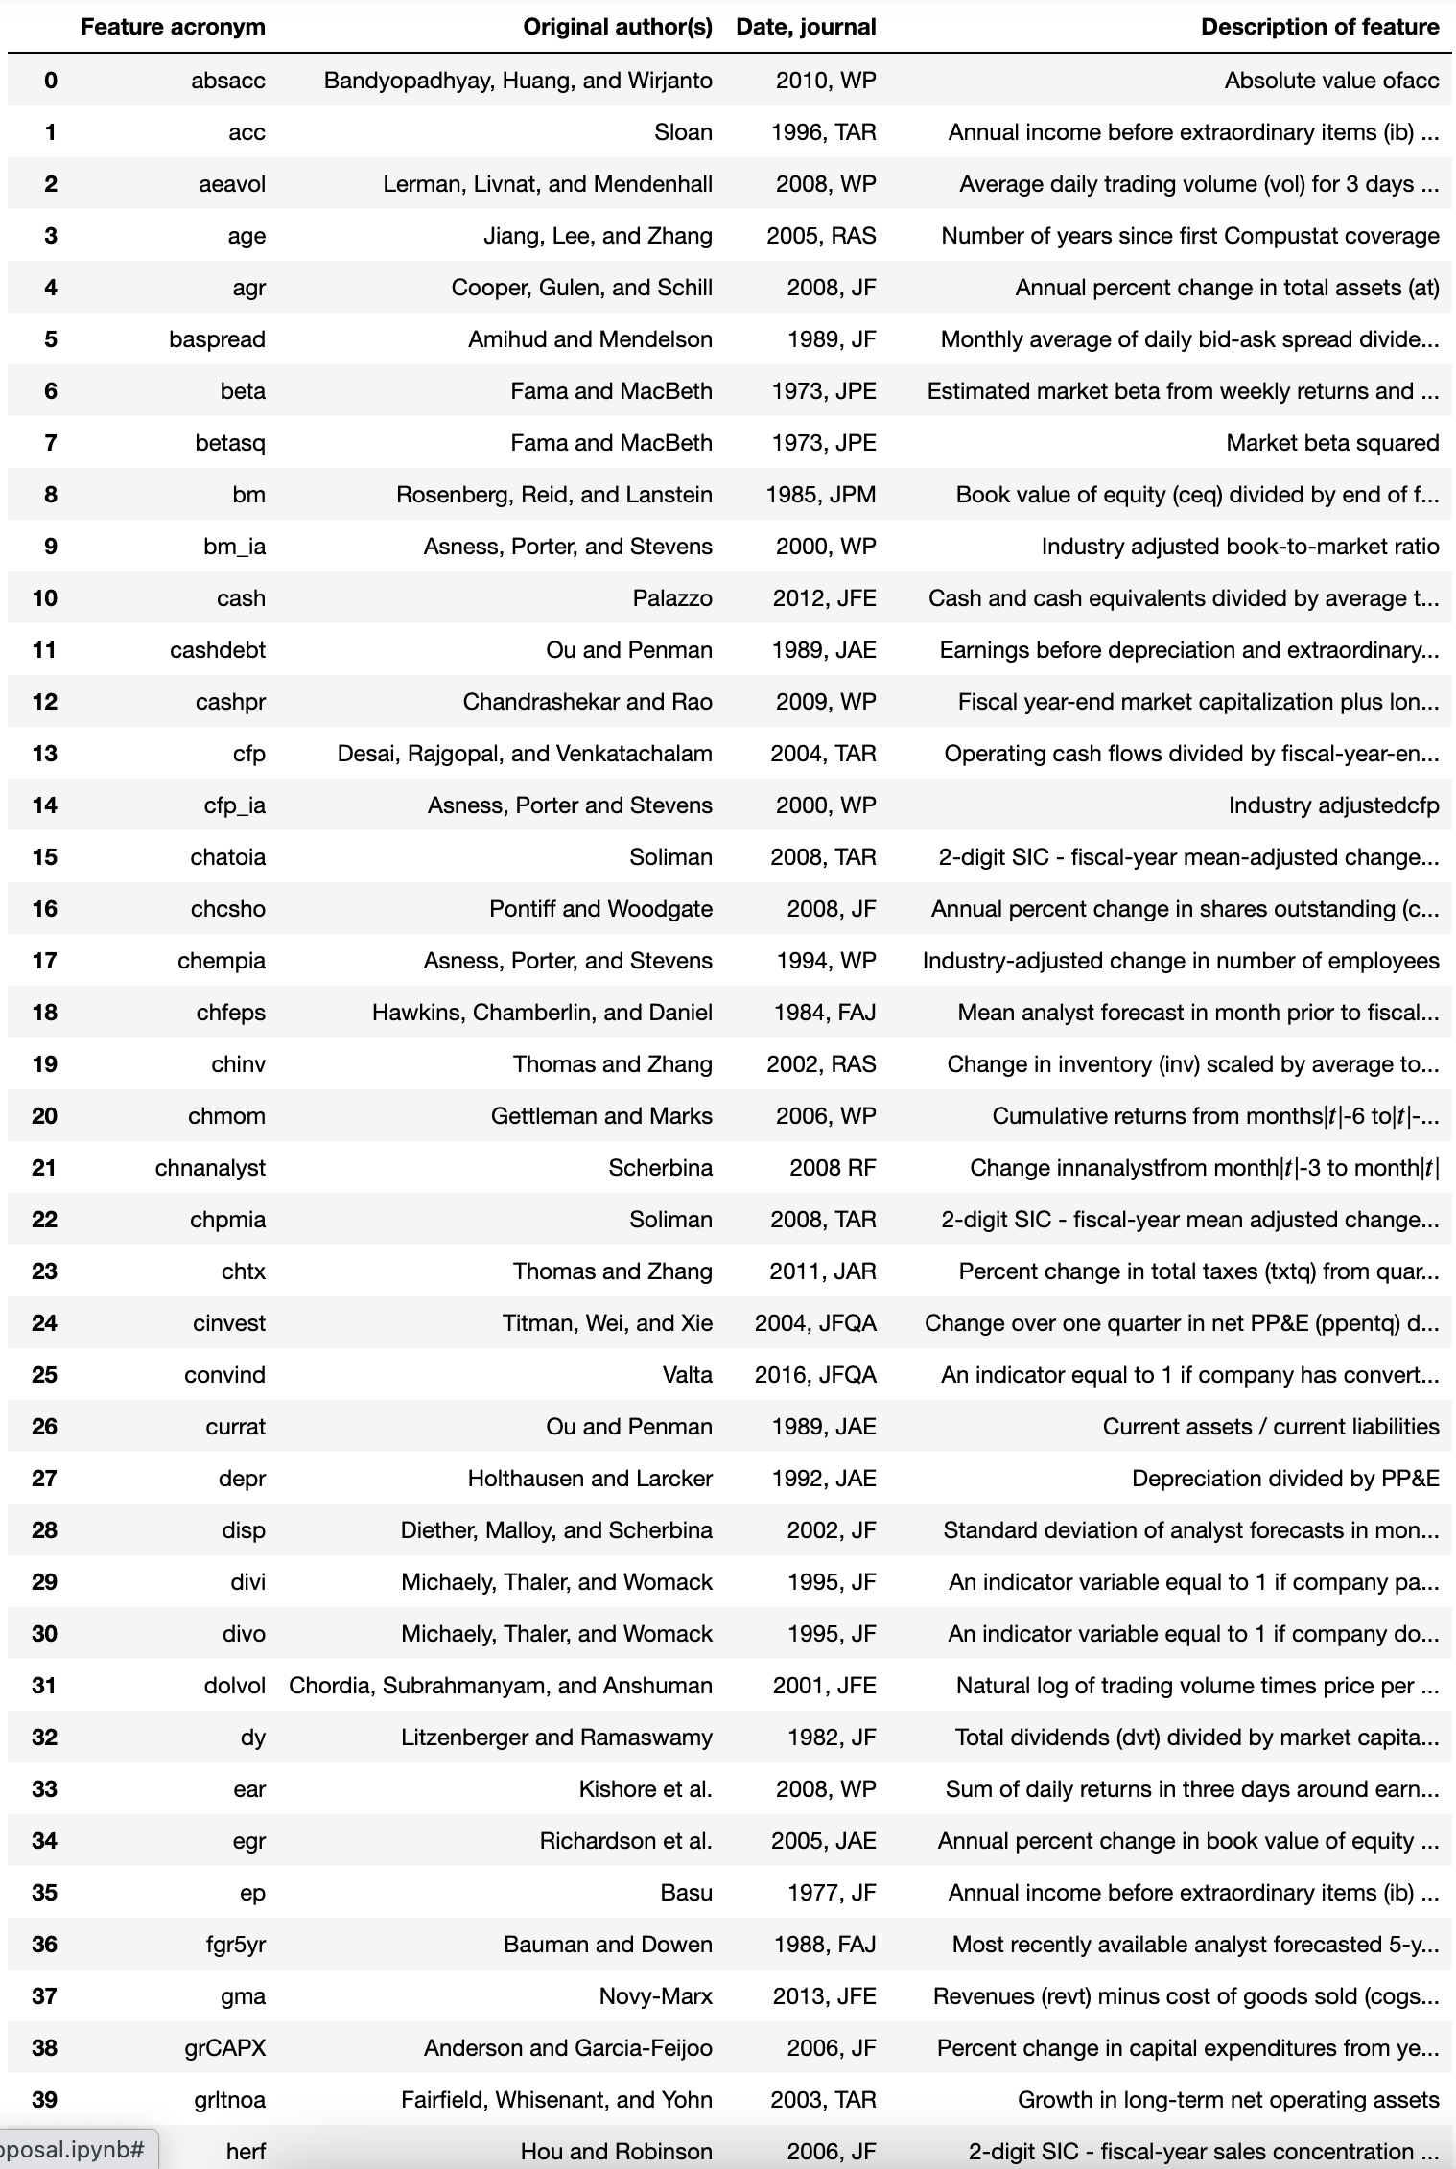
Modelling Approach
94 stock-level features
15 machine-learning models
Plenty of sweat, blood and pain
…including a total hard disk wipeout

Slide 6
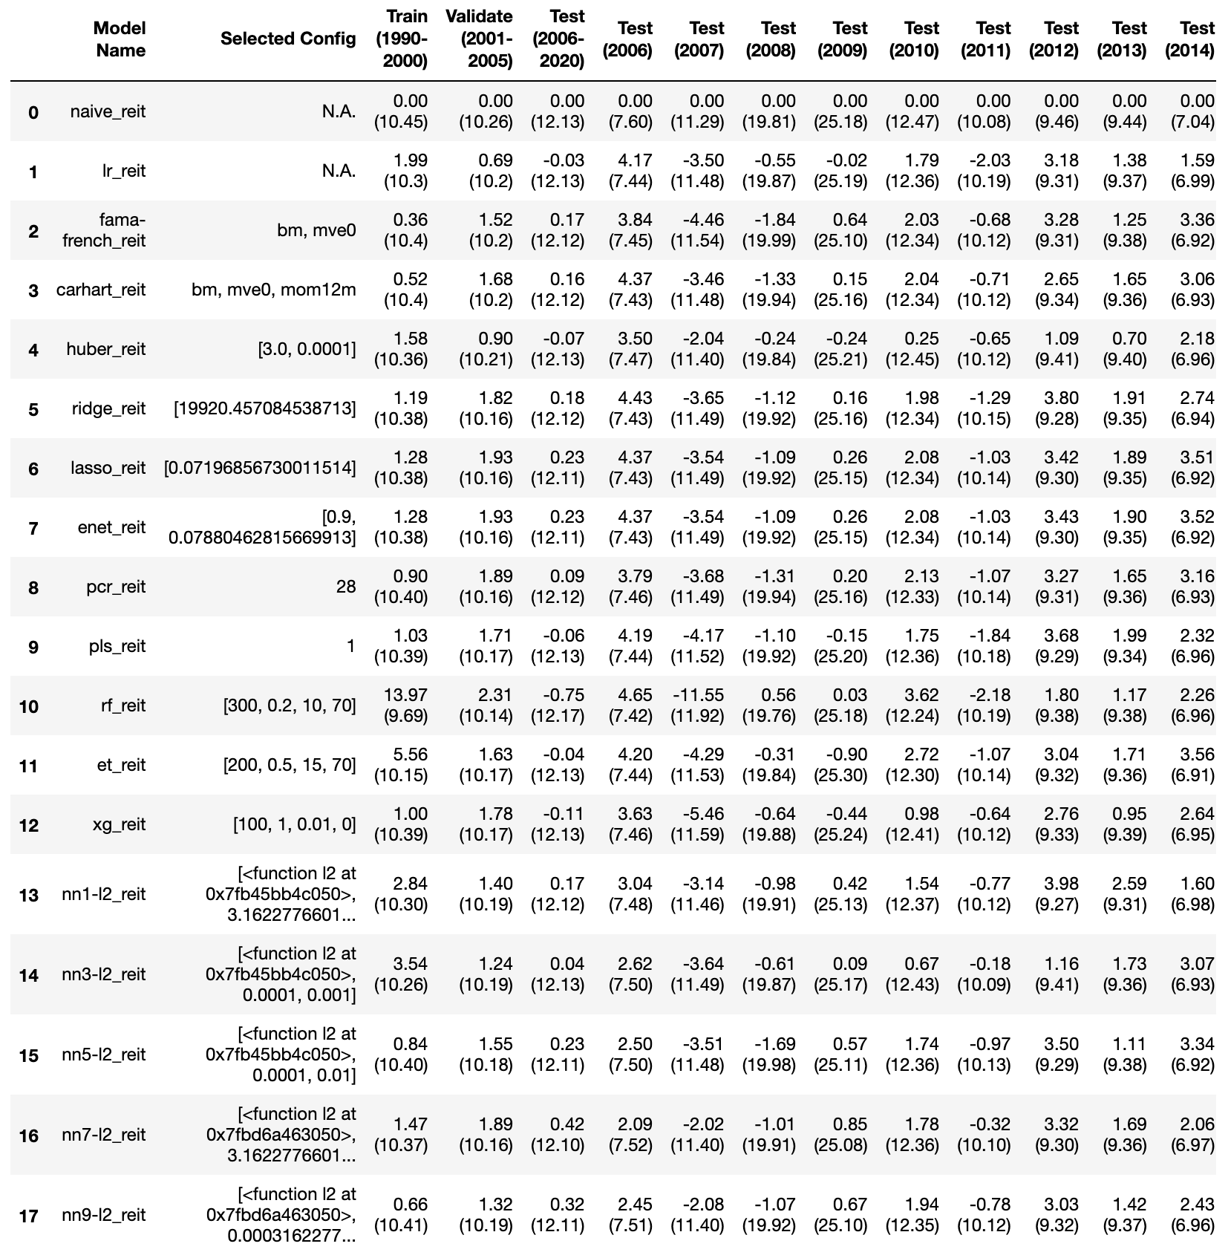
Results
Plain OLS can’t work…overfits
Tree regressors are worse
Regularized regression are better
Neural networks are the champs
All models cannot deal with 2007’s subprime crisis

Slide 7
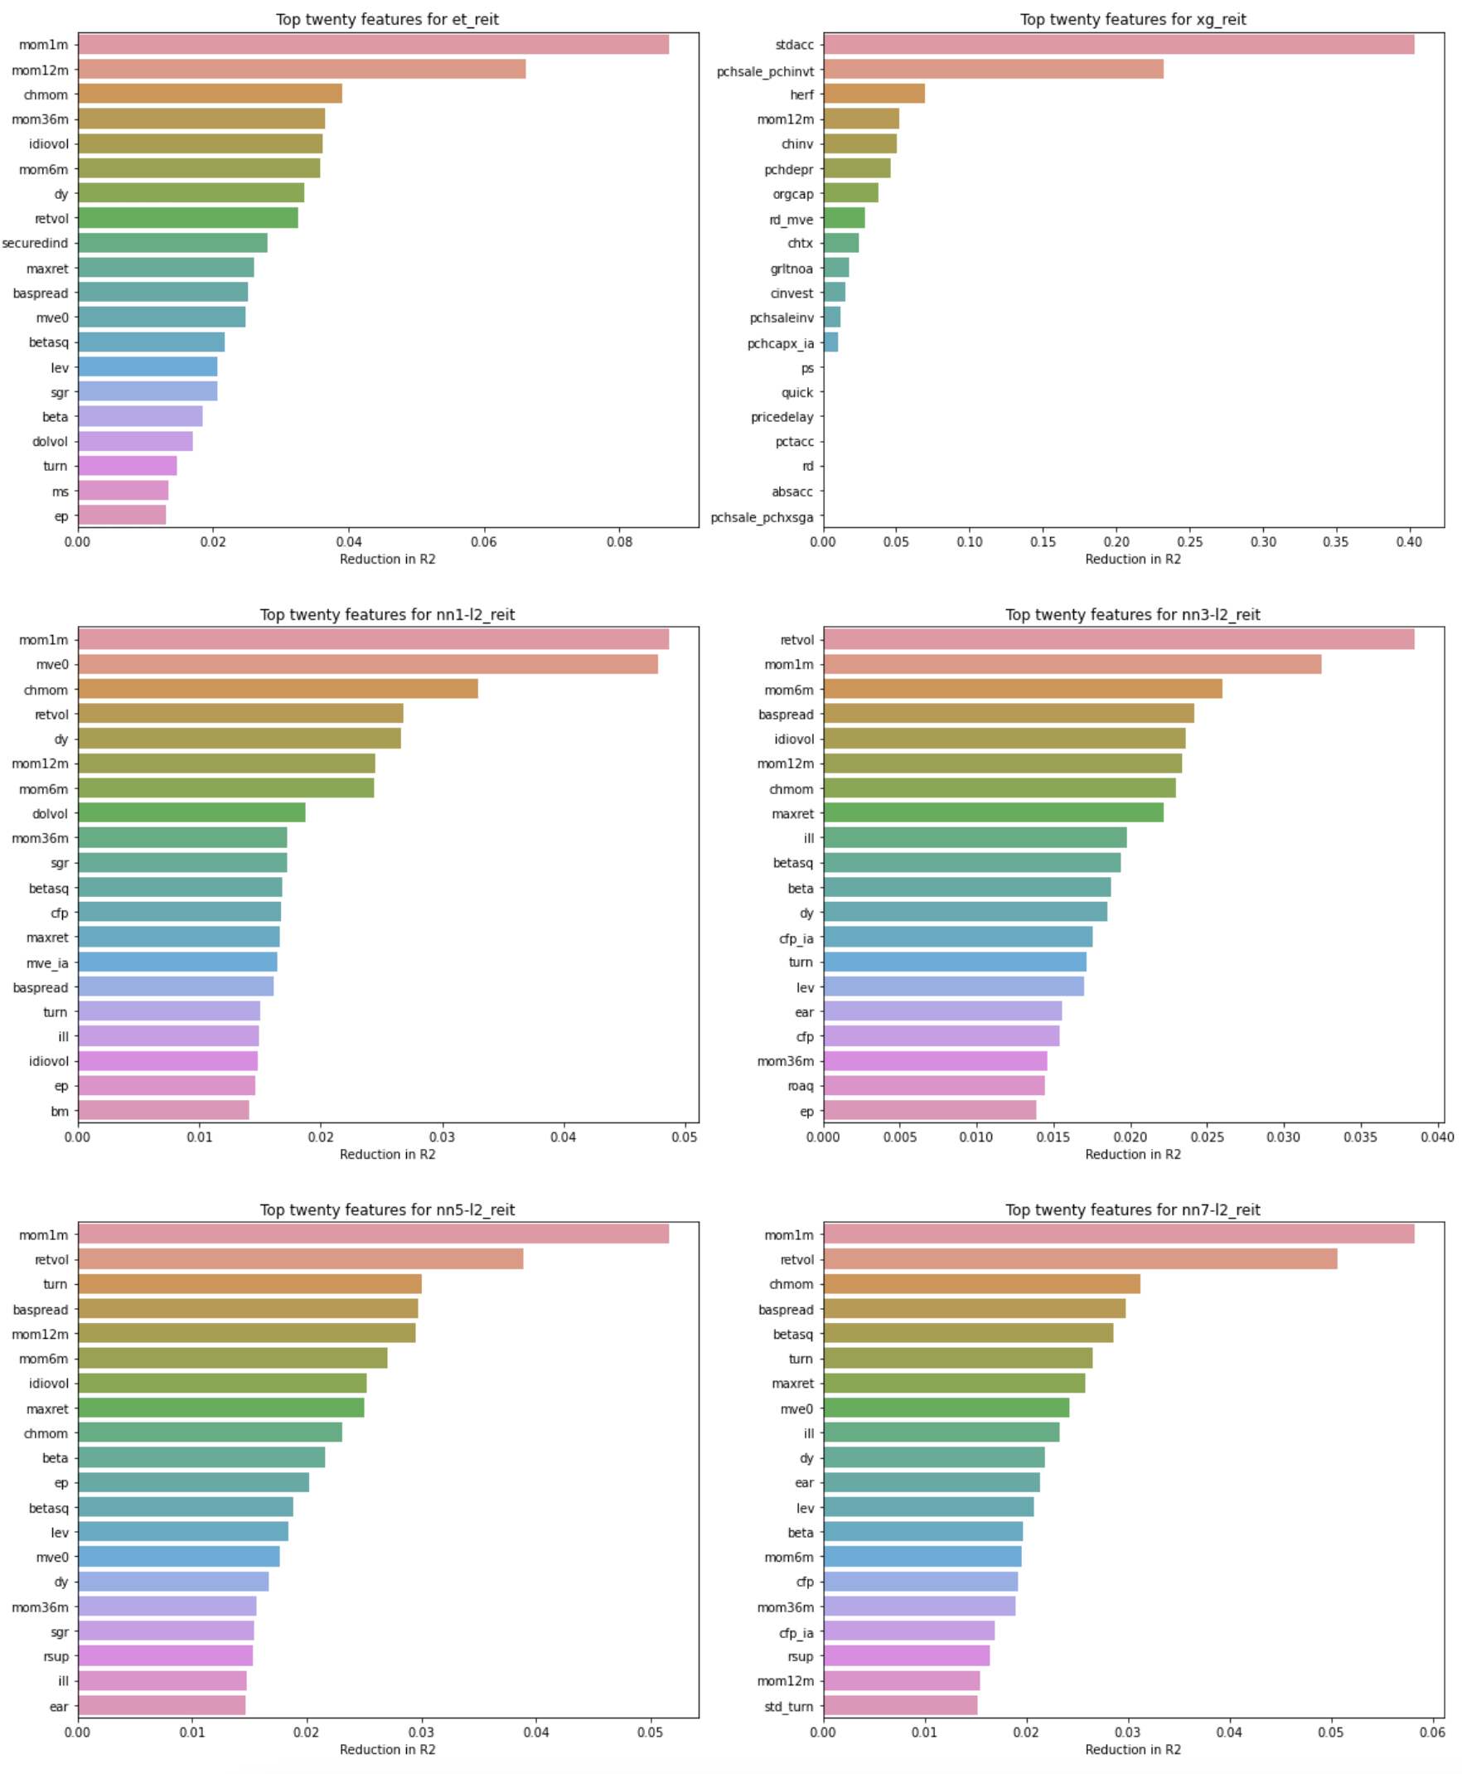
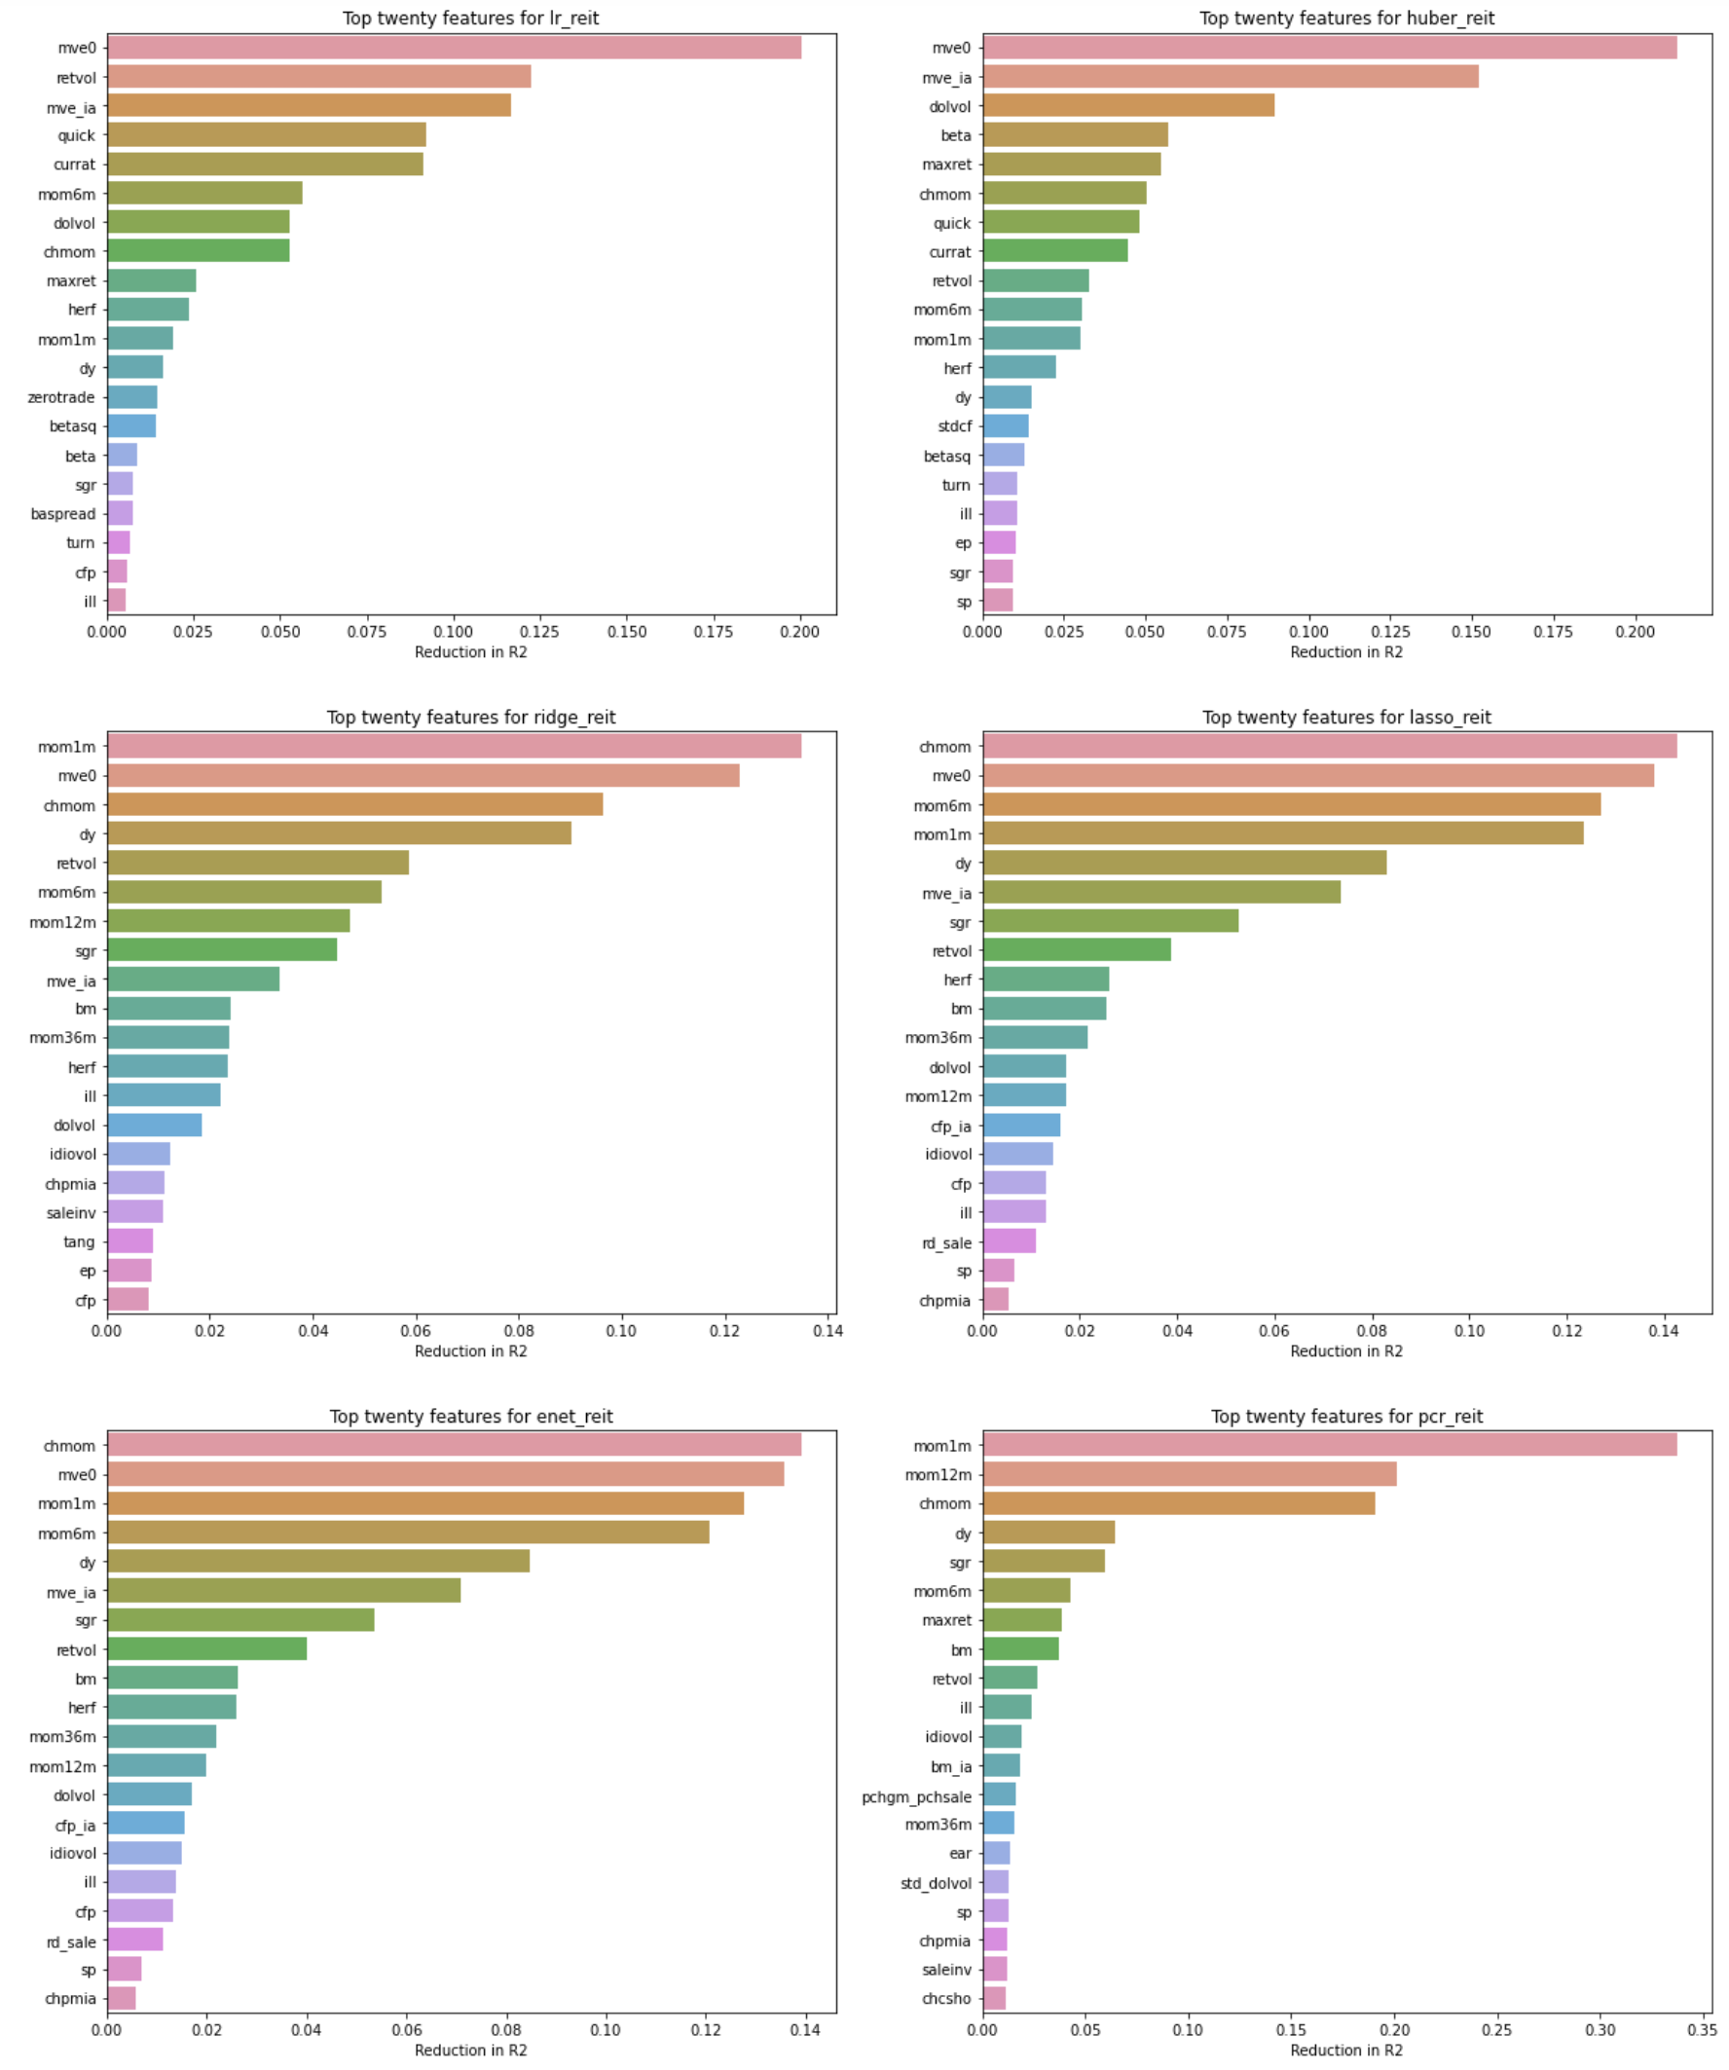
Features of importance
Measures the drop in R² by setting the feature of interest to 0 (remember all features are already standard-scaled)
Allows ‘black box’ models such as Principal Component Regression and Neural Networks to be assessed on an equal footing with regression models such as OLS and Elastic Net
Market cap (mve0), momentum factors (mom1m, mom6m, mom12m, chmom), return volatility (retvol), bid-ask spread (baspread) seem to be the most common features of importance
Tree-based regressors have very different features of importance from other machine-learning models

Slide 8
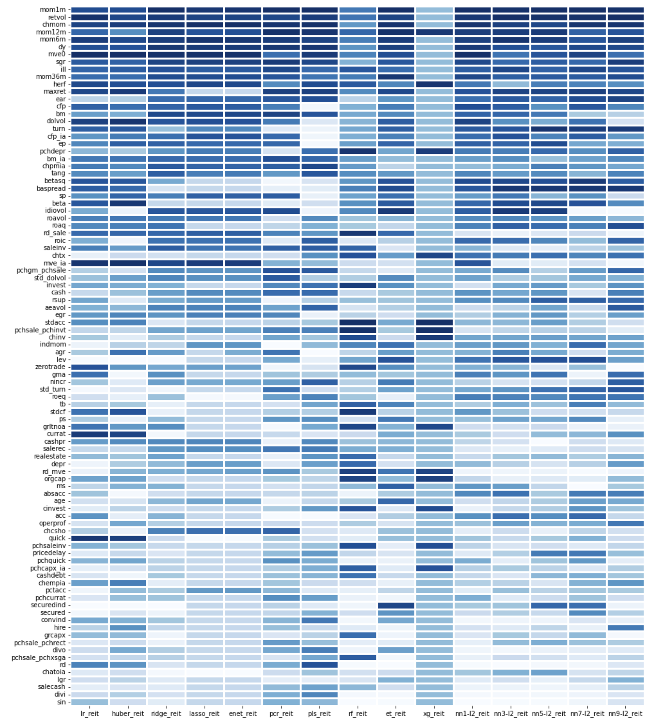
Features of importance
On average, 1-month momentum is the highest-ranked feature across all models
Return volatility is next highest
Random Forest and XGBoost can’t make it…all important features for them contradict other models
Somehow, Extra Trees seem to agree with other models, even though its R² is negative

Slide 9
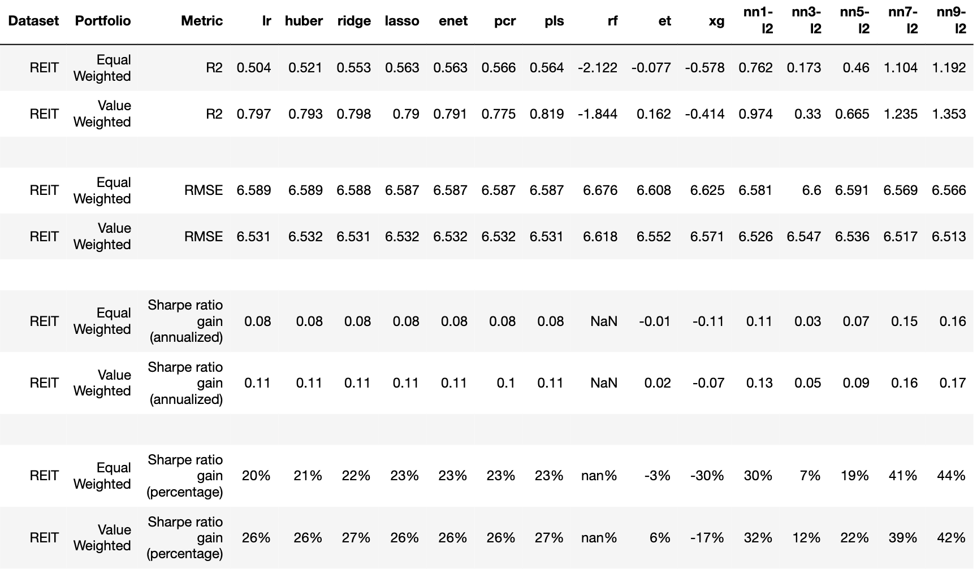


Portfolio Performance
Plain OLS is not too bad at the portfolio-level, despite overfitting at the stock-level
Tree regressors are terrible
Neural networks are the champs…even better on a portfolio level!!

Slide 10
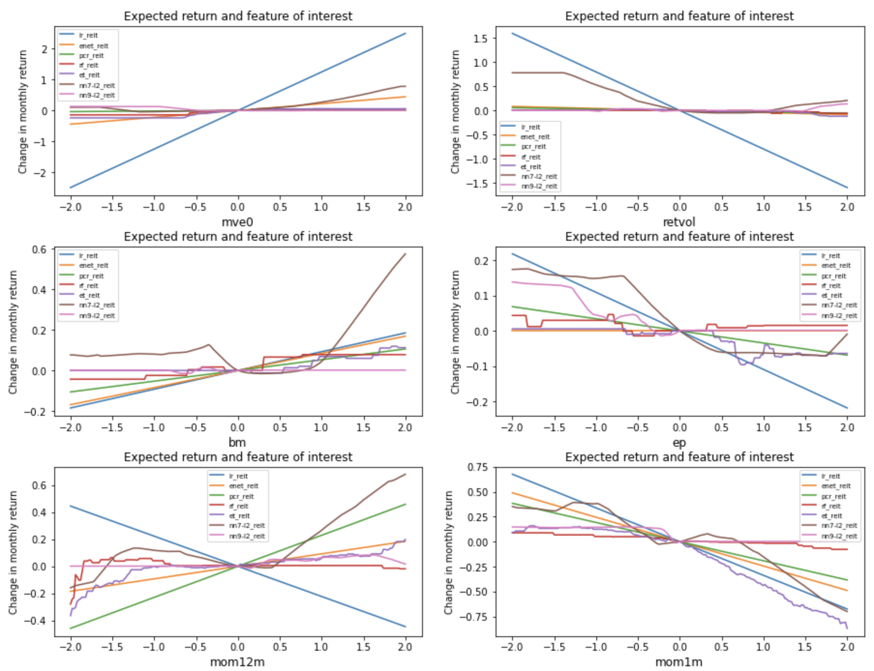
Marginal effects (Part 1)
Evident why regression models (OLS, Enet, PCR) can’t perform as well
Life is not so simple like a straight line
For example, traditional theory says that large book-to-market ratios imply higher expected returns while low ratios imply lower returns
However, neural networks says chotto matte… yes, higher positive bm ratios imply higher returns, but please ignore low bm ratios else you might suffer badly if you go against them (think Tesla and FAANG stocks)

Slide 11
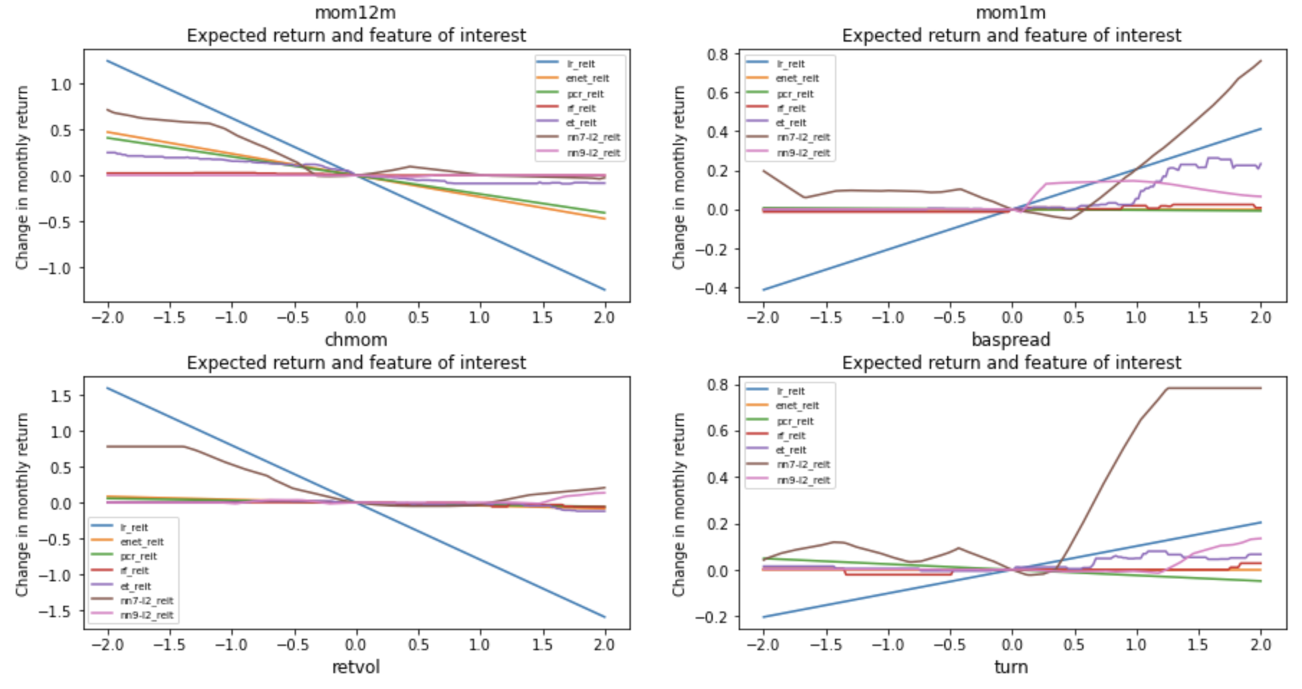
Marginal effects (Part 2)
Same for other variables
OLS say REITs with high trading volume imply higher expected returns and low volume imply lower returns
BUT… neural network say: leave REITs with low trading volume alone… short them at your own risk → but keep your focus on REITs with high trading volume, they should have higher expected returns

Slide 12
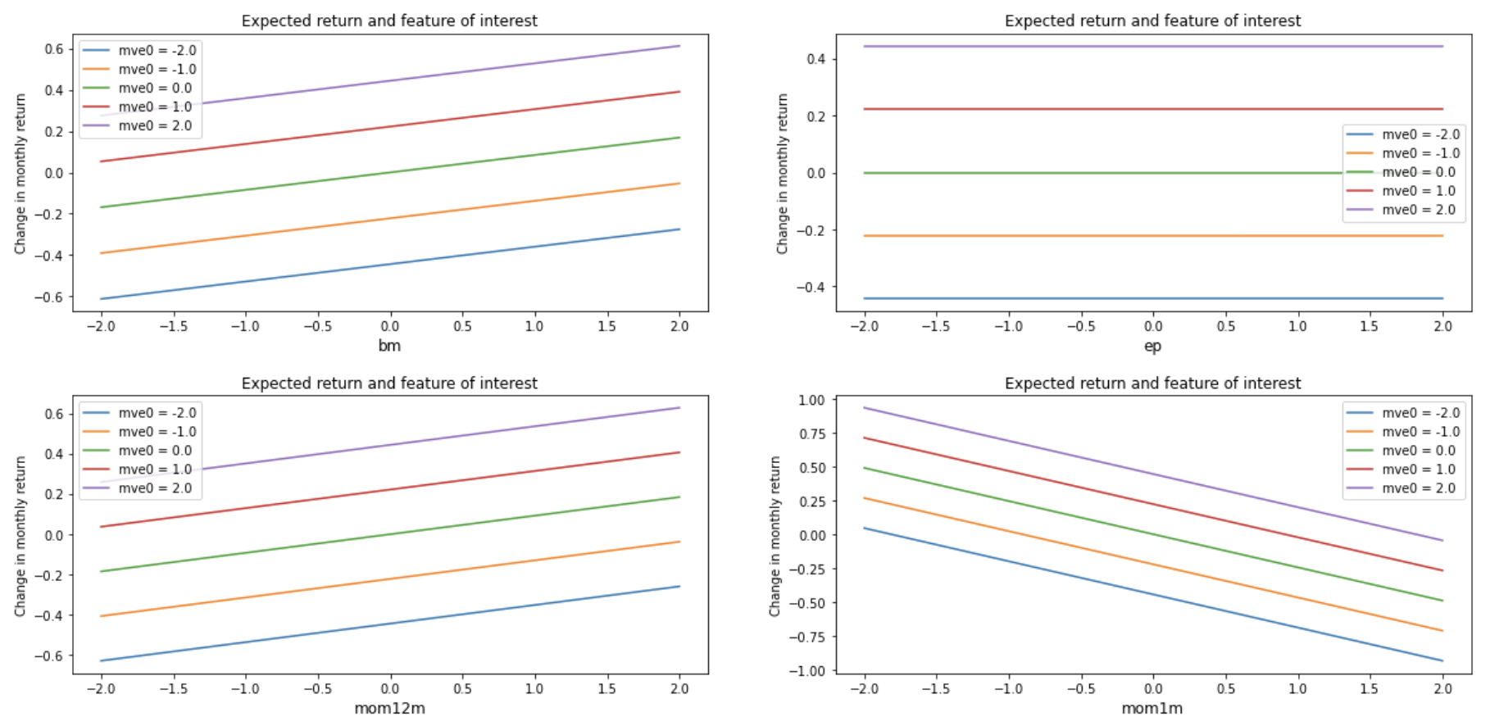
Interaction effects (Part 1)
The ability of neural networks to detect and capture non-linear predictive associations between expected returns and features is amazing
For example, NN7 is telling us to ignore 1-month momentum or earnings-to-price rations for the largest REITs if it is negative, but to consider it seriously if it is positive
A regression-based machine-learning model like Elastic Net has no choice but to impose a linear relationship across the entire spectrum of feature values, from negative to positive…
NN - 7 Layers
Elastic Net

Slide 13
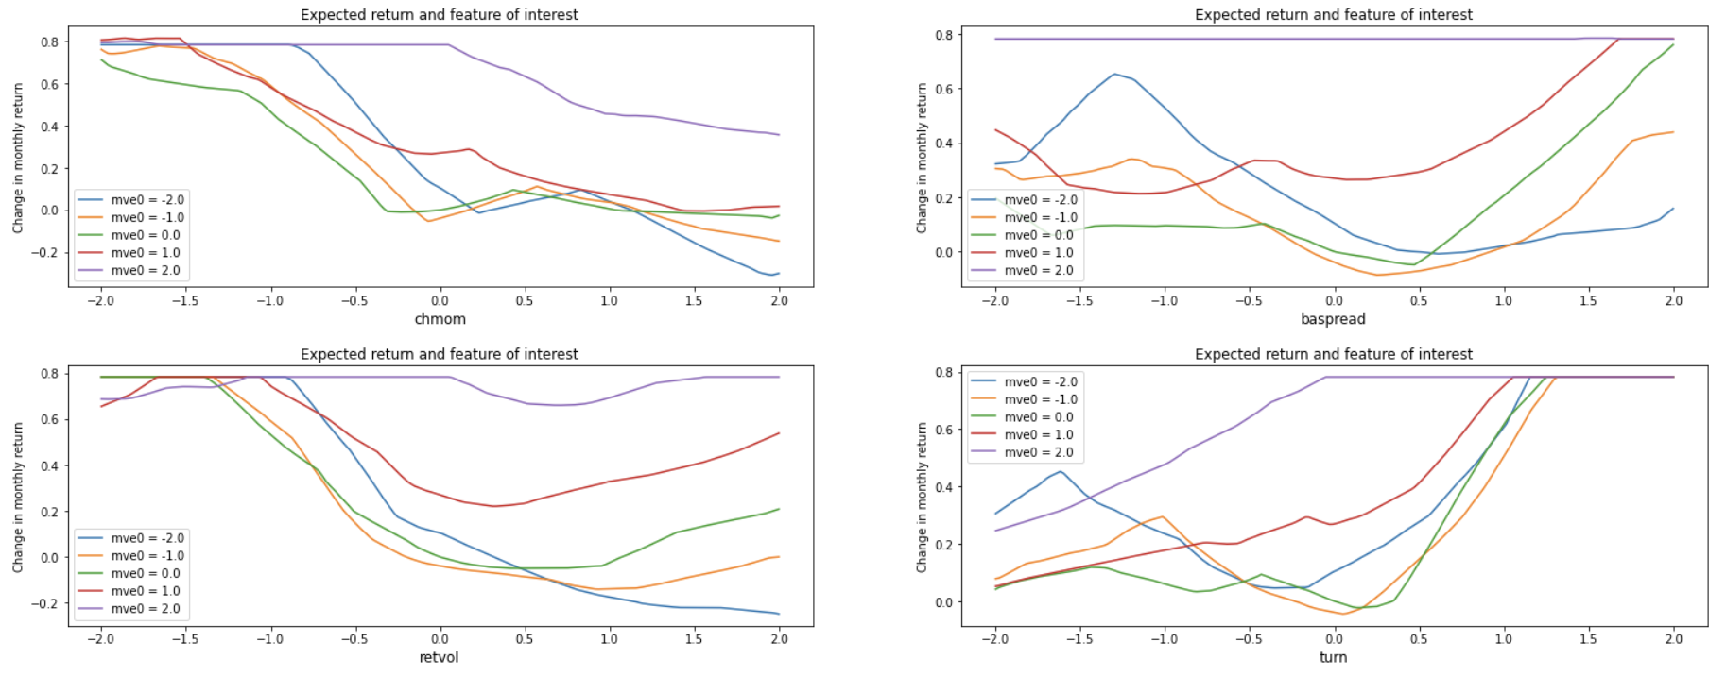
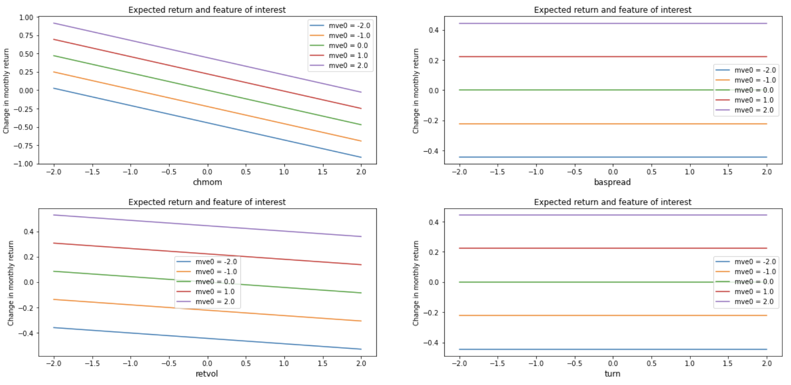
Interaction effects (Part 2)
Regression-based models are unable to deal with unordered behavior
E.g. larger companies have larger effect on expected returns than smaller companies (purple line is always higher than red, with blue at the bottom)
However, non-linear models like neural networks can accept that life is not so simple
When monthly trading volume turn is low, the smallest stocks outperform largest stocks, but when trading volume is above average, large stocks will outperform small stocks
NN - 7 Layers
Elastic Net

Slide 14
Further areas to explore
Recurrent neural network (long short-term memory models)
Hierarchical time series forecasting (Meta, Uber)
Non-trivial to execute with panel data, but payoffs can be huge if one can figure out time-based cross-sectional predictive ability!

